Slide 1
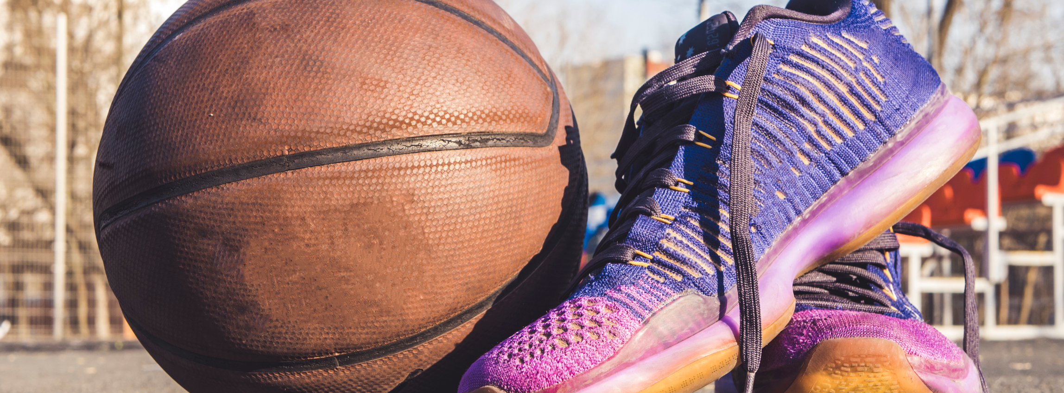
Violence and Sports
Presented by: Your name
Reference to course

Slide 2
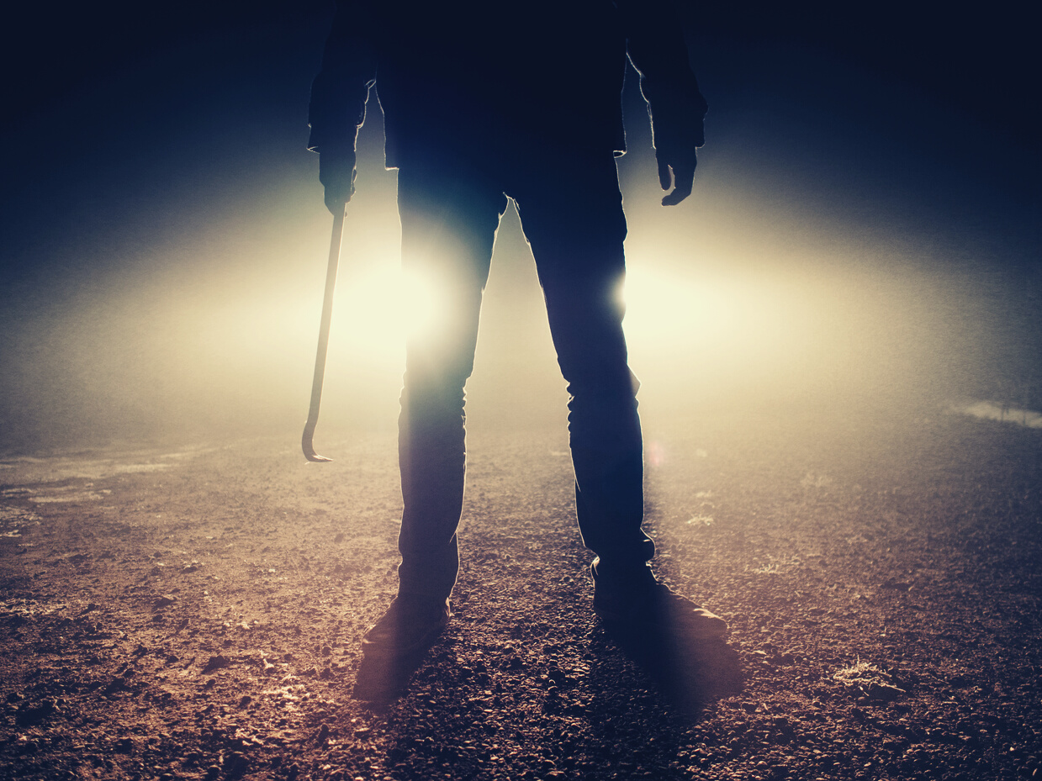
Violence in Sports
Sports violence refers to behavior that causes harm
and occurs outside the rules of the sport.
These include intentional attempts to:
injure player by another player or coach
threats of physical harm or actual physical harm sustained by players or coaches by those engaged in looking out sports

Slide 3
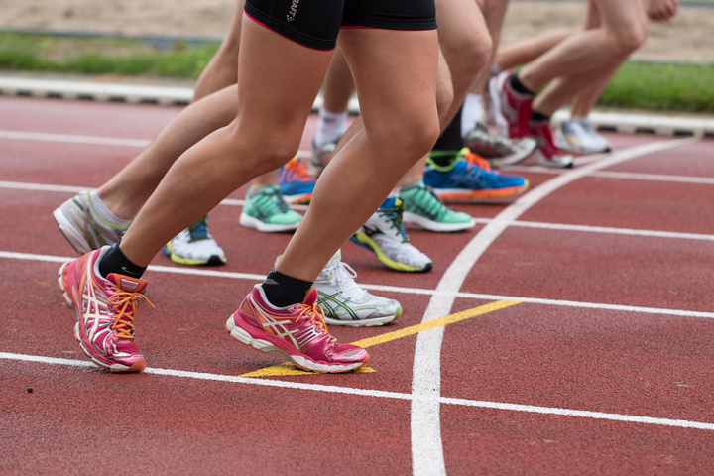

Introduction
Increased spectatorship of sports continues to be experienced in major types of sports where aggression may arise.
Violence in sports is not only dangerous to the participating team fans, team players but other stakeholders too.
There have been traditional notions focused as concerns the causes of the violence
Recently, there is increasing evidence of the presence of hatred towards violence among the stakeholders in sports thoughtfully because of the consequences involved, among other things.

Slide 4

Historical Background

Slide 5
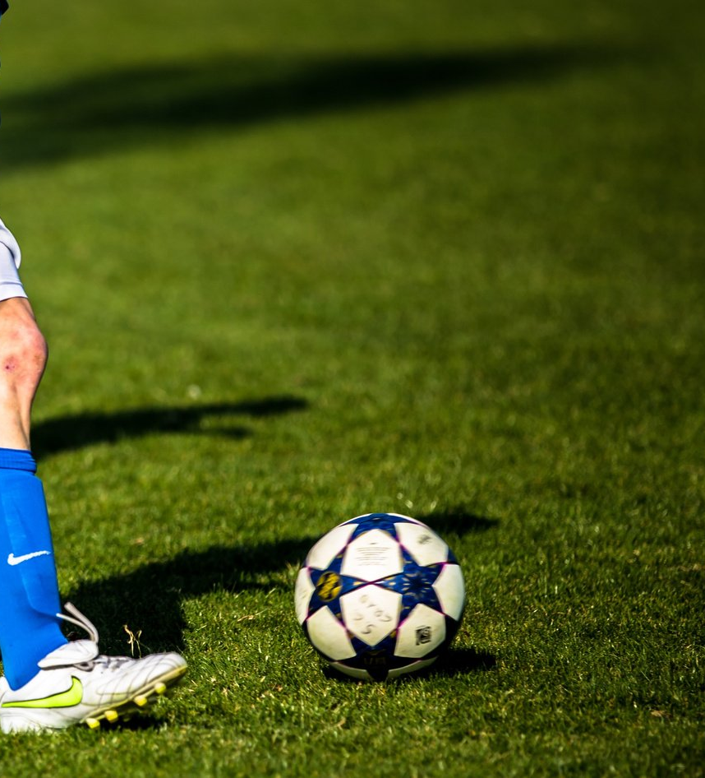
Historical background
Greeks are reportedly among the nations that first expressed ideal athletics sports with the videos (fair, dignified characteristics, modesty) characteristic,
History indicates that the sports in Greek involved bribery and corruption, and the principle of sports violence was endorsed as a social norm and accepted during the Roman Empire.
Causes of violence range from the decision of the referees to increased negativity among the fans; there is a need, therefore, to engage in extensive research as concerns ways of reducing and controlling sports violence.

Slide 6
Reasons behind the sports violence

Slide 7
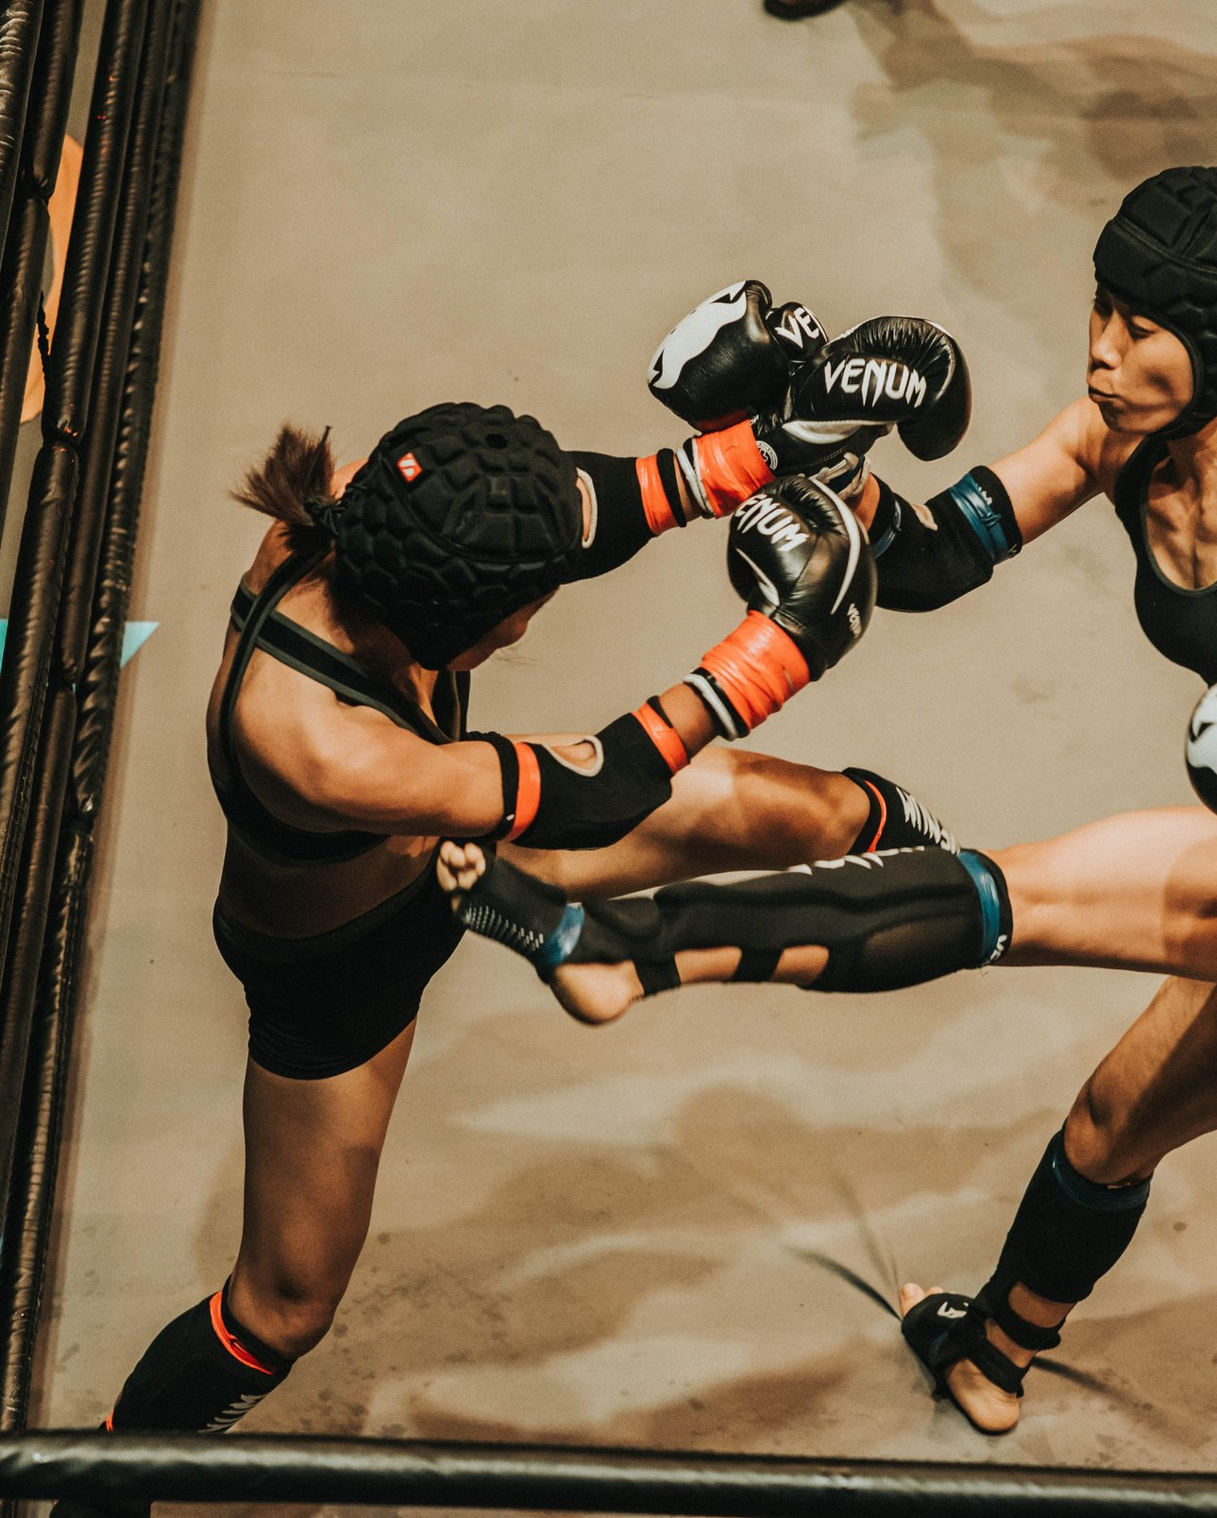
Reasons
The importance of result
Nature of the game
Provocation by crowd
Game's pressure
Lack of sportsmanship awareness
No punishments for violence

Slide 8
Sports violence prevention

Slide 9
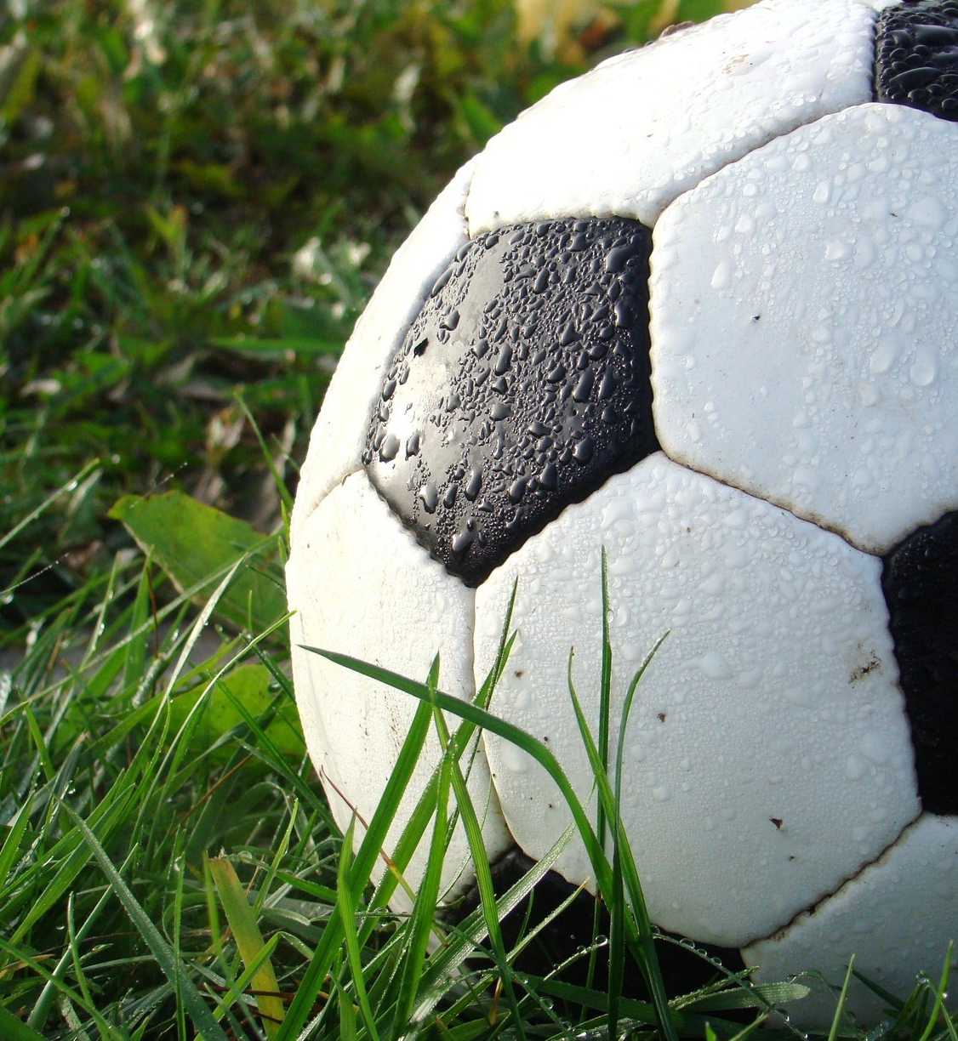
Prevention
Make the players aware of sportsmanship spirit
Train them for stressful matches
No excess external pressure should be on players
Stress management should be taught to the on-field person.
Higher authorities should define clear cut punishments for violators.

Slide 10
Impacts of Violation

Slide 11
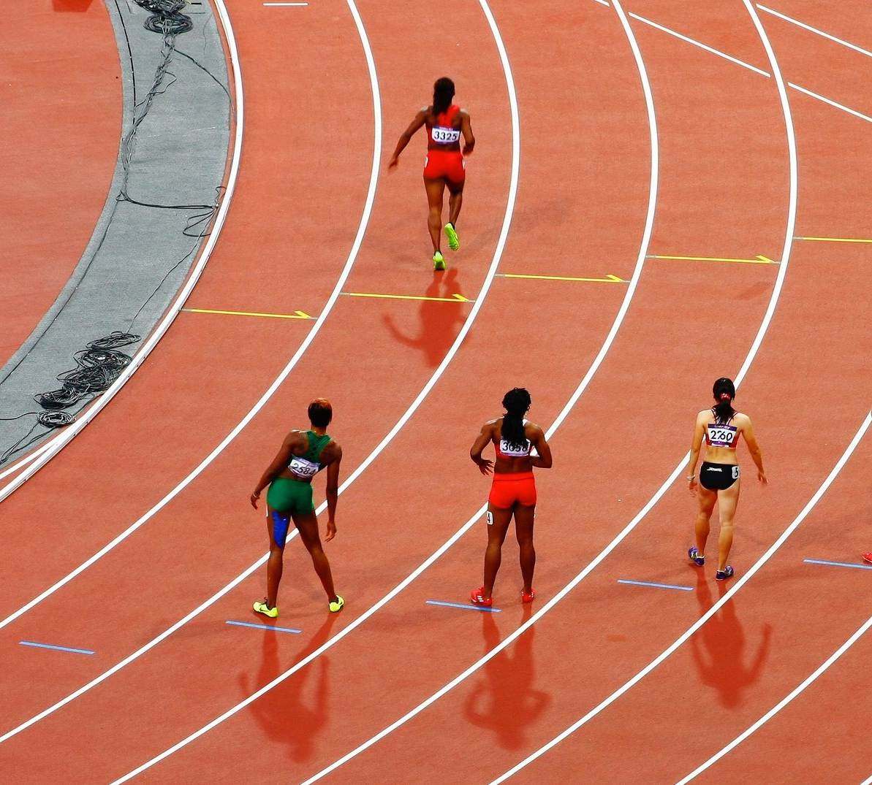
Impacts
Damage sports reputation
Loss of earning
Bans and punishments
Credibility loss
Loss of sponsorships
Lack of trust by fans
Cause of suspicion for other athletes

Slide 12
References
Clark, P. “An anatomy of high school hockey riot”. The Hockey news. (1981). 24(24) pp. 7-8
Coakley, J.J. Sport in Society. Boston: McGraw-Hill. (1998)
Coakley, Jay J. Sport in Society, Issues and Controversies (Second Edition). St. Louis: C.V. Mosby Company. (1982)
Hardcastle, Jonathon “Sports Violence.” Sports Violence. EzineArticles.com.
Larry M. Lance. “Views of Violence in American Sports: A Study of College Students”. College Student Journal.. FindArticles.com.
Messner, M.A. Power at play. Boston: Beacon Press. (1992)
Messner, M.A. and Sabo, D.F. Sport, men and the gender order. Champaign, Ill.: Human Kinetics Publishers. (1992)

Slide 13


